Slide 1

Fundamental of Business Lesson 2
Instructor: P Pavalaxan
April 2024

Slide 2
Learning outcome
Understand the term “organization”
Discuss the nature and types of organizations
Examine the management functions in organizations.

Slide 3

Organization
Who?
Formally organized group of people
What?
Act of taking an efficient and orderly approach
Why?
Achieve a common goal

Slide 4
Organization
G. E. Milward: “Organisation is the harmonious inter-relation of functions and staff.”
Mooney and Reiley: “Organisation is the form of every human association for the attainment of common purpose.”
Louis A. Allen: “Organisation is the process of identifying and grouping the works to be performed, defining and delegating responsibility and authority and establishing relation­ship for the purpose of enabling people to work more effectively together in accomplishing objectives.”

Slide 5
Organization’s Purpose and Priorities
Mission - All of the people in an organization should be working toward a common purpose. That purpose is often referred to as the mission. The statement is often reviewed during a process called strategic planning.
Vision - The organization’s vision is an image of what success would look like at some point in the future, both for the people that the organization serves and for the organization itself.
Values - The organization’s values are the overall priorities in the nature of how the organization wants to work toward its mission. Values can be reflected in how the people in the organization are actually working together.
Strategic Priorities - These are the overall, most important matters and activities for members to attend to when working toward the mission. The priorities are often referred to as “strategic goals” during a strategic planning process.

Slide 6
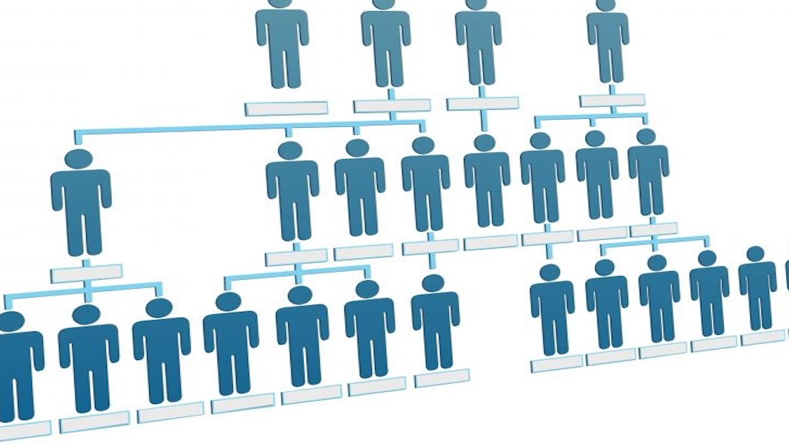

Organizational Structure

Slide 7
Organizational Structure
Organizational structure is the method by which work flows through an organization. It allows groups to work together within their individual functions to manage tasks.
Characteristics are;
Work specialisation
Chain of command
Span of management
Centralization and decentralization

Slide 8
Type of Organizational Structure
Several factors determine the type of organizational structure that a company uses:
revenues,
number of employees,
diversity of products,
types of customers and
geographical spread.
Smaller companies have more informal cultures while larger corporations are more formal and bureaucratic.

Slide 9
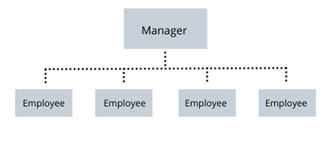
Flat
The flat structure dispenses with the usual hierarchy of a functional structure, decentralizing management and doing away with the need for middle manager bosses.
Employees essentially act as their own boss, giving them the ability to communicate directly with peers on ideas and projects.

Slide 10
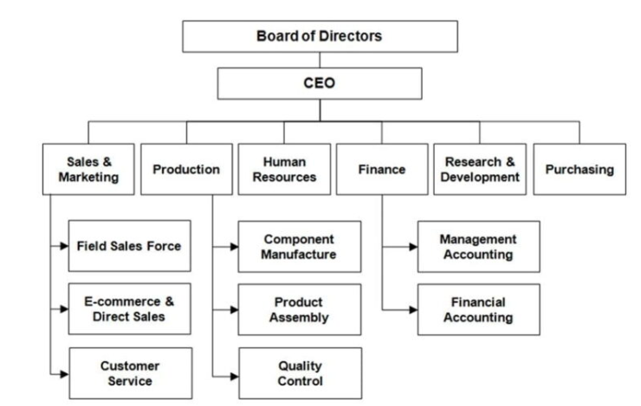
Functional
A functional structure is the most traditional approach.
It calls for grouping together people who do similar tasks based on their area of specialty.
Ex. All the accountants in finance and all the marketers in marketing.
Managers led each area and report up to a director or executive who may oversee multiple departments.

Slide 11
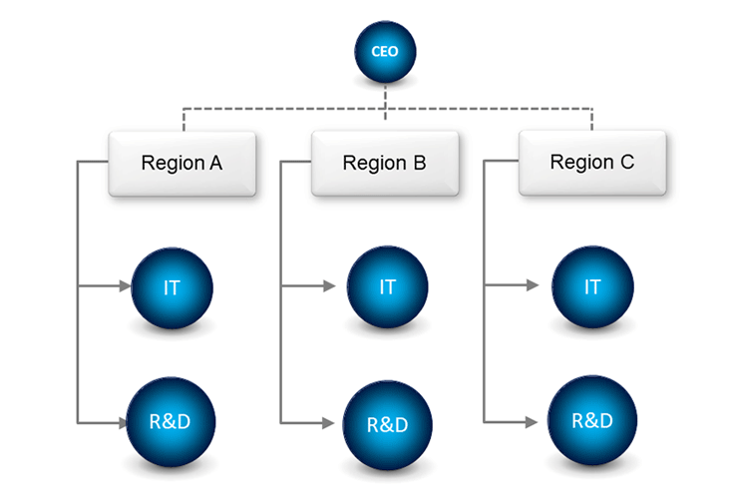
Divisional
People are grouped together based on the product or service they provide, not the work they do.
Ex. Large corporation such as General Electric has divisions for electronics, transportation, and aviation, each with its own team of accountants, marketers, etc.
Global corporations may have divisions based on different geographic areas

Slide 12
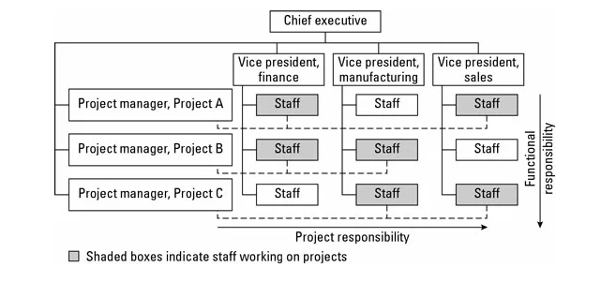
Matrix
A matrix structure is a hybrid of the functional and divisional structures.
It may involve employees reporting to different bosses depending on their current assignment.
Ex. A software design specialist may report to her boss in IT, but also brought onto specific projects because of expertise. When that happens, she will report to a different boss as long as that project continues.

Slide 13
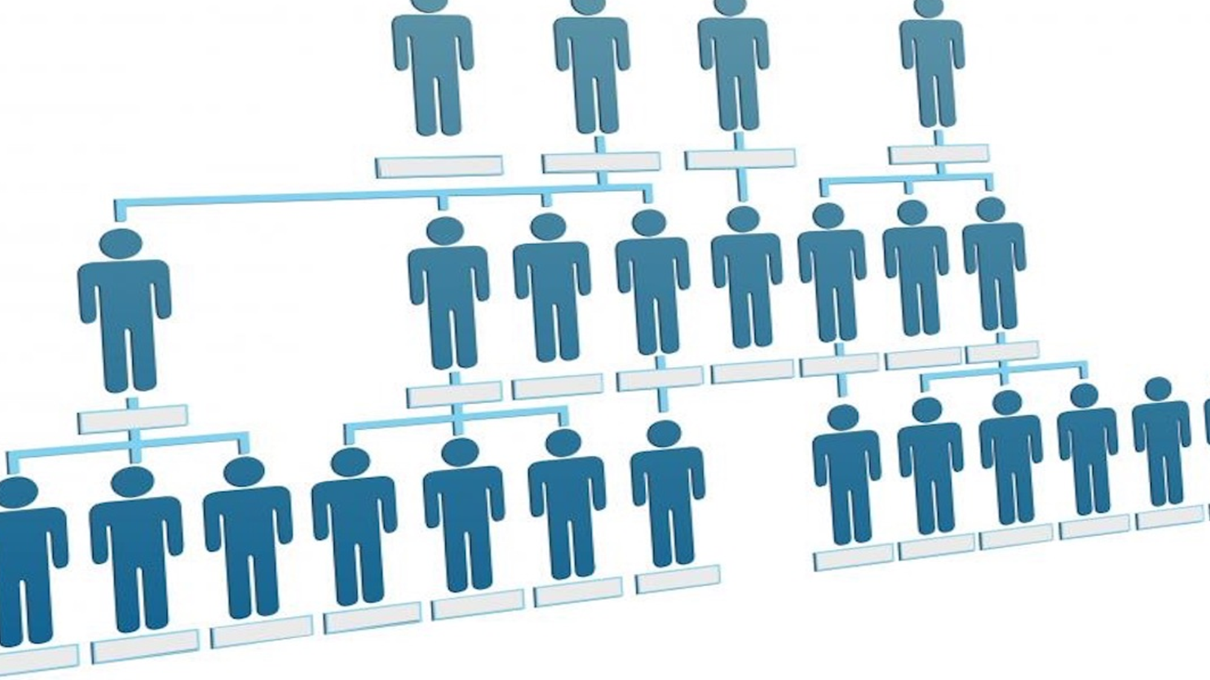
Organizational Structure
Important
Better Communication
Clear Reporting Relationships
Growth And Expansion
Efficient Task Completion
Fits Company’s Needs

Slide 14
Organizational Structure
Activity : What Can Go Wrong?
Poorly structured organizations find that critical deadlines are not met because there were not sufficient human resources in each department to accomplish all parts of a given task, or because it was not clear whose ultimate responsibility the project was. If individuals are not sure whom they report to, they may find they are given conflicting assignments by two or more managers above them.

